Slide 1
Code output
KAWEESI CHRISTOPHER 2023-B071-30759

Slide 2
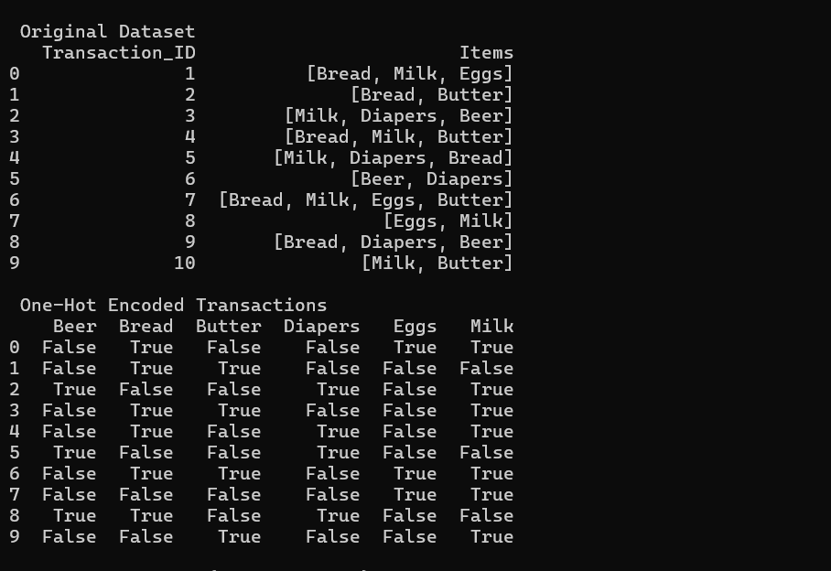
PART A DATASET AND TRANSACTION

Slide 3
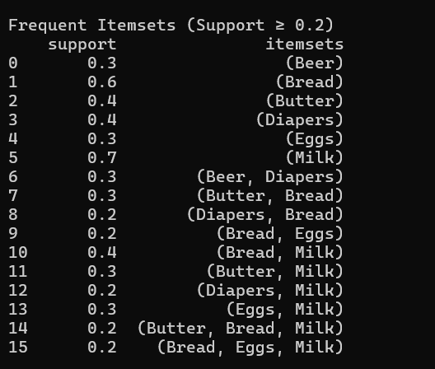
PART B APRIORI ALOGORITHM= FREQUENT ITEMSETS

Slide 4
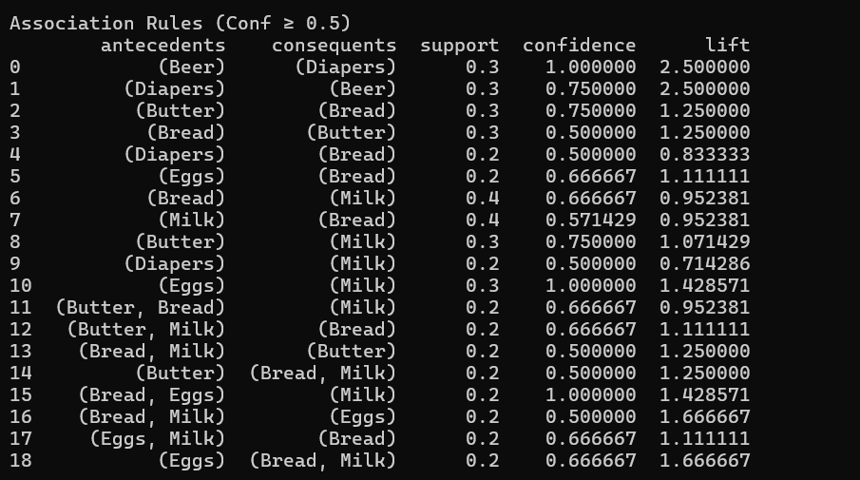
ASSOCIATION RULES

Slide 5
PART C: INTERPRETATION: Strongest Association Rules Based on Lift
Diapers → Beer
This rule shows that customers who buy diapers are much more likely to also buy beer during the same shopping trip. The high lift value indicates a strong relationship between these two products, meaning their co-occurrence is not random.
Bread & Milk → Butter
The rule indicates that when customers purchase bread and milk together, they are very likely to include butter in their basket. This reflects complementary purchasing behaviour for common household or breakfast items.
Eggs → Milk
This rule suggests that customers who buy eggs often also buy milk. The strong association implies that these items are staple goods frequently purchased together.

Slide 6
Business Recommendations
Improve Store Layout and Cross-Merchandising
Items with strong associations, such as diapers and beer, should be placed closer together or highlighted in joint promotions to increase cross-selling and impulse purchases.
Introduce Bundle Offers and Discounts
The supermarket can create bundled promotions for frequently co-purchased items such as bread, milk, and butter. This strategy can increase sales volume while enhancing customer convenience.

